Slide 1


The Access Dilemma
Analysis of diabetes and socio-economic status
By: Amy Ying Lin, Elina Dart, Manny Linares, Kevin Daniliuk

Slide 2
Diabetes + Socioeconomic Status
We chose this topic because of our interest in diabetes and how so many people in our lives are affected by it.
Knowing that communities of lower socioeconomic status are more heavily impacted, we wanted to learn why?
We want to see what it will take for those populations to have the resources necessary in preparation for living longer with better health outcomes.
The number one way for people with lower socioeconomic status to achieve better results is to catch their diabetes earlier.

Slide 3
Studies have shown a relationship between low socioeconomic status and barriers to quality healthcare access.
Globally Low Socioeconomic Status is linked with poor health outcomes. (World Bank, 2014)
American Diabetes Association reported that Low Socioeconomic Status is related to increased diabetes mortality rates. (Diabetes Care, 2012)
“Racial/ethnic minorities are disproportionately affected by barriers to health care access and utilization.” (Kollannoor-Samuel et al., 2012)

Slide 4
Questions
What demographics and socioeconomic factors are correlated with diabetes?
Based on these factors, who will likely get diabetes?
How successfully can demographics and socioeconomic status predict diabetes?
What are changes/solutions that can be made to positively impact this issue?

Slide 5
Technology
Extract, Transform and Load: Jupyter Notebook, Python (Pandas, Numpy, SQLAlchemy)
Database: PgAdmin4/PostgreSQL.
Exploration: Tableau
App for Diabetes Prediction: Flask app, Python, Javascipt and html.
Dashboard: HTML, Javascript, Bootstrap
Machine Learning: Jupyter Notebook, Google Colab Notebook, Python (SkLearn, SQLAlchemy)

Slide 6
Data Source
2021 National Health Interview survey (NHIS) from the Centers for Disease Control and Prevention (CDC)
Tracks health status and health care access of Americans since 1957
Monitor progress toward national health objectives
Identify and work on significant health problems.
Data size: ~ 30,000 rows (individuals), 622 columns
Data includes: demographics, health status, insurance, income

Slide 7
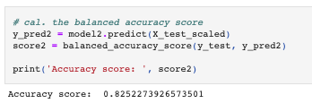
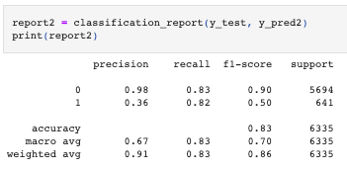


Machine Learning
Notes:
Amy will explain the machine learning model we’ve selected and why she/we chose it. Please tell us about the other machine learning models you tried. What struggles did you experience?
Accuracy, precision, and recall scores.
After training the model, we created binary files that our app can use to predict the probability of some new individual having diabetes.

Slide 8
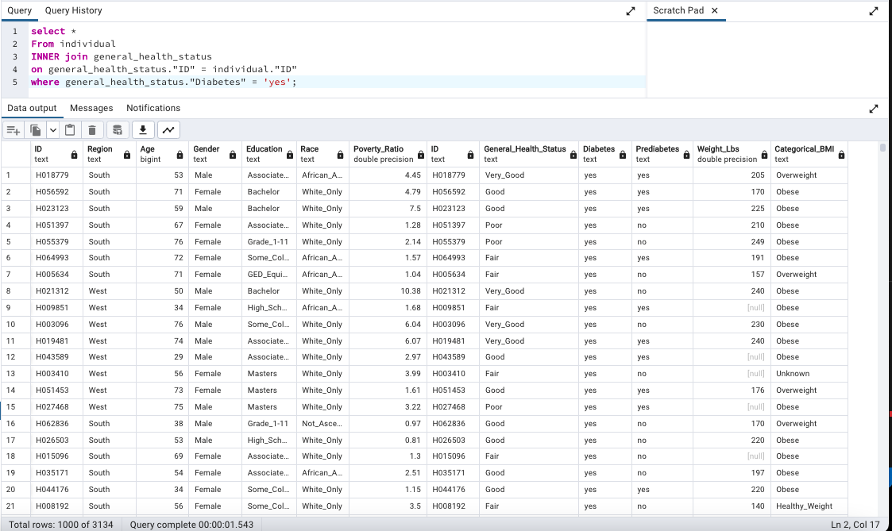
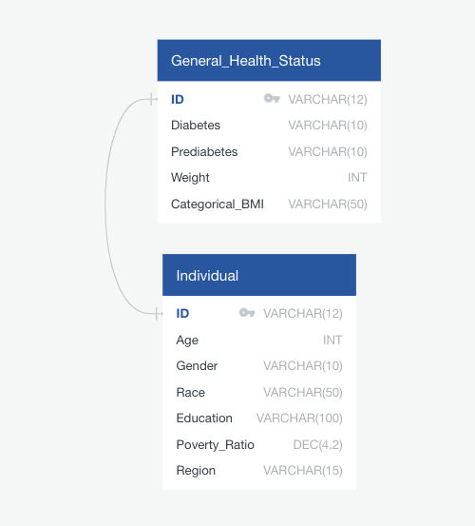
Database

Slide 9
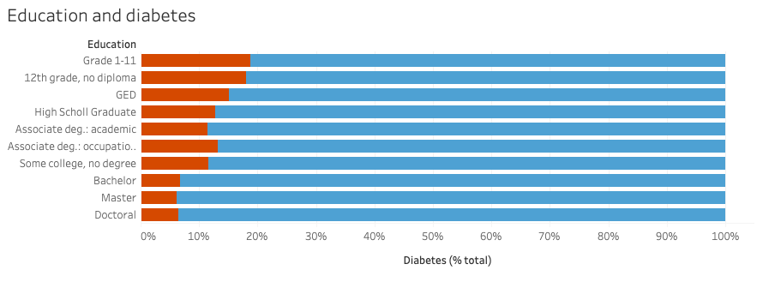
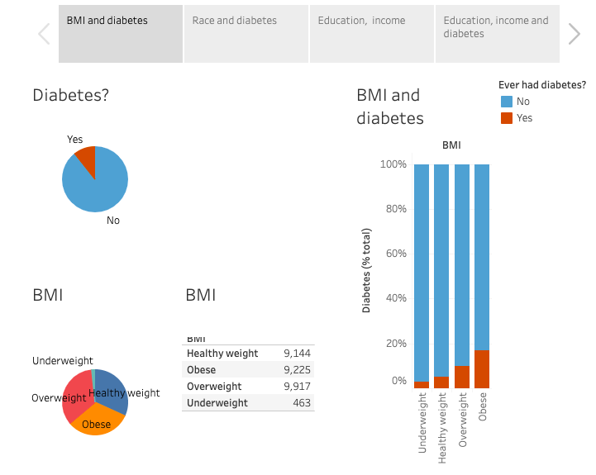
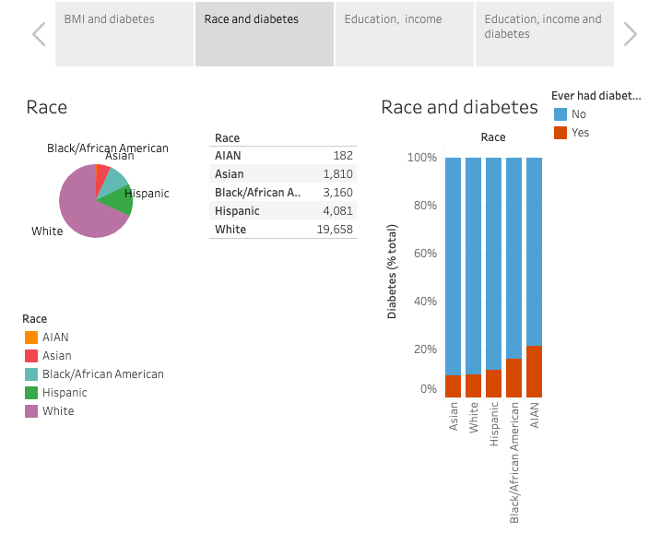
Exploration
Notes:
Machine learning model
Statistically significant variables
Accuracy, precision, recall scores.

Slide 10
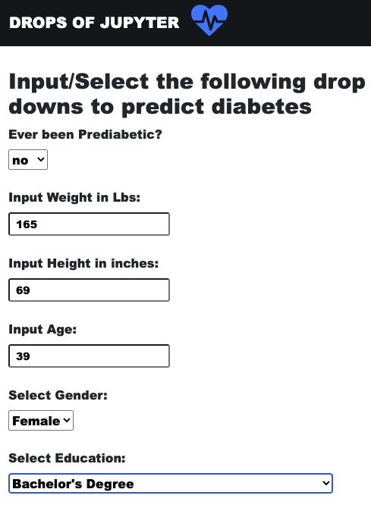
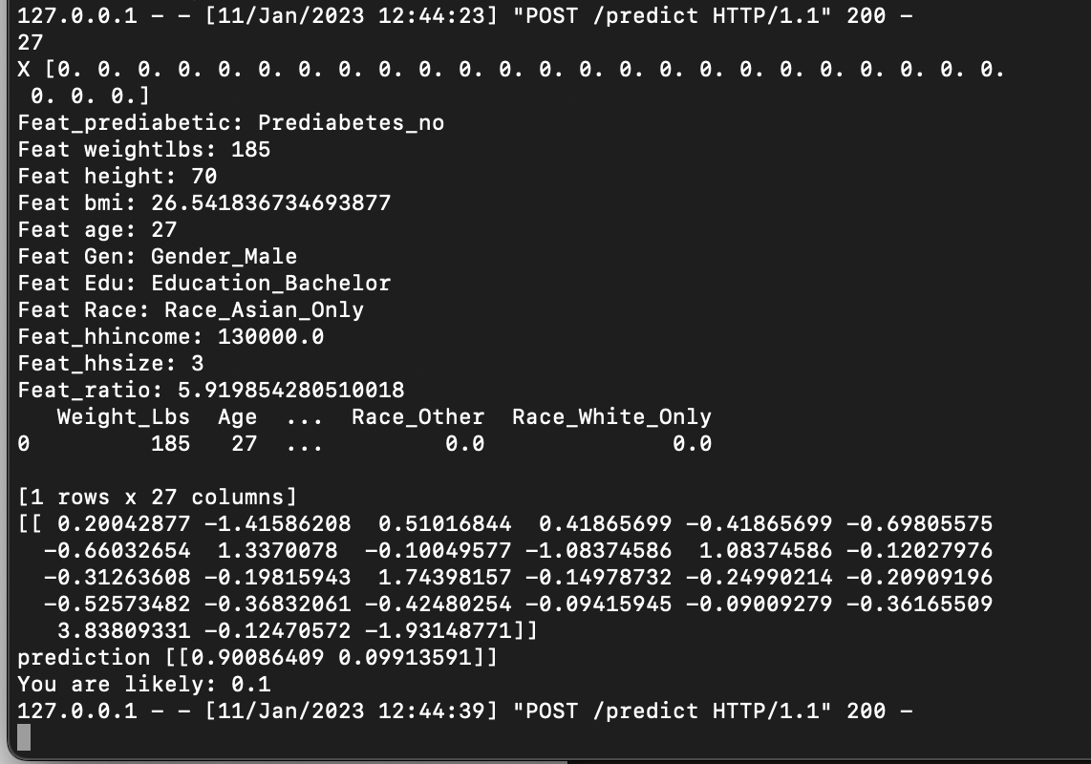
Results: An App that user can use to predict diabetes.

Slide 11

How we could improve?
Notes:
Conclusion: What we would do differently in the future. (go back to the slides? I should find a picture for a mobile app?)
We were hyperfocused on the SES variables and so overlooked the opportunity to run a correlation function on all 600 columns of our original data set. In the future we’d likely run that first to help us identify important variables
Our model has a very large number of categorical variables which can affect the predictive power of our model. We would like to test SVM and RFC models for future versions of our app since those can sometime handle categorical variables more reliably.
We have built a framework here that would allow us to integrate a CDC API in the future and load new data into our database when ever CDC releases it and then further train our data on many more observations. This will further improve our model’s scores.

Slide 12



Questions?

Slide 13
References
2021 National Health Interview Survey (NHIS)
https://www.cdc.gov/nchs/nhis/index.htm
Centers for Disease Control and Prevention
https://www.cdc.gov/
Google
https://www.google.com/
Stack Overflow
https://stackoverflow.com/

Slide 14
References cont’d
Kollannoor-Samuel, Grace, Sonia Vega-López, Jyoti Chhabra, Sofia Segura-Pérez, Grace Damio, and Rafael Pérez-Escamilla. “Food Insecurity and Low Self-Efficacy Are Associated with Health Care Access Barriers Among Puerto-Ricans with Type 2 Diabetes.” Journal of immigrant and minority health 14, no. 4 (2012): 552–562.
https://diabetesjournals.org/care/article/36/1/49/38282/Socioeconomic-Status-and-MortalityContribution-of
https://www.worldbank.org/en/topic/health/brief/poverty-health

